Slide 1
LUCIDCARE: AN ENSEMBLE PATIENT CENTRIC CLINICAL REPORT INTERPRETATION USING EXPLAINABLE AI
Guide: Ms. Geethu Gopan, Asst. Professor
Team Members:
Abhishek Biju (MUT22AD005) Alina Pinheiro (MUT22AD014) Joel S Mathews (MUT22AD043) Roshen Reji (MUT22AD062)
Batch No.: 1
Group No. : 2

Slide 2
PROBLEM STATEMENT
Medical reports are often written in complex technical language, making them difficult for patients to understand. This creates a communication gap and limits patient involvement in their own care.
Hence, there is a need for an AI-driven solution that simplifies medical reports and provides bilingual explanations to improve accessibility and understanding for local patients.
LucidCare, AI&DS

Slide 3
OBJECTIVES
Develop a multimodal AI system that integrates a Large Language Model (LLM) and a Vision Ensemble Model to analyze medical reports and chest X-Rays images.
Generate simplified and accurate medical explanations that are easy for patients to understand.
Enable comparison studies, to compare previous and current outputs to identify changes such as, increases vs. decreases in medical parameters.
Provide bilingual support (English and Malayalam) to make medical information more accessible and understandable for regional language speakers.
LucidCare, AI&DS

Slide 4
EXISTING SYSTEM
Existing systems use Large Language Models (LLMs) to help patients understand complex medical reports.
These systems automatically convert technical medical jargon into simple, easy-to-read summaries, improving patient comprehension.
However, most existing solutions focus only on textual medical data, without incorporating insights from medical images such as chest X-Rays.
This limits the system’s ability to provide a complete and accurate medical explanation that combines both text and visual information.
Additionally, most systems generate output only in English, which can be a disadvantage for regional patients who prefer or require information in their native language.
LucidCare, AI&DS

Slide 5
DISADVANTAGES OF EXISTING SYSTEM
No Direct Image Analysis The system relies entirely on the written report rather than the raw image data.
No Explainable AI (XAI) The model provides conclusions without exposing the reasoning path or the features that influenced them.
No Multilingual Support The system primarily operates in English, creating accessibility barriers for non-English-speaking clinicians and patients.
One-Way Flow No communication between text and image models.
LucidCare, AI&DS

Slide 6
LITERATURE SURVEY
DETAILS OF PAPER | OVERVIEW | ADVANTAGES/TECHNIQUES/ ALGORITHM | LIMITATIONS
A vision–language foundation model for the generation of radiology reports Bluethgen et al., 2024 | Presents a vision–language foundation approach that adapts large latent-diffusion and VLM techniques to chest X-Rays for generating realistic synthetic CXRs and conditioning text-image generation for report-related tasks. | Uses domain adaptation of a pre-trained latent diffusion model and vision–language alignment to produce controllable image synthesis and downstream radiology tasks. | Focuses mainly on synthetic-image generation and VLM pretraining adaptation, with limited evaluation of direct clinical report fidelity and real-world deployment constraints.
Vision-language models for medical report generation and visual question answering: a review Iryna Hartsock and Ghulam Rasool, 2024 | Comprehensive review of medical vision-language models (VLMs), summarizing architectures, datasets, pretraining strategies, and evaluation metrics for report generation and VQA. | Synthesizes progress across model architectures and pretraining strategies, helping identify best practices for multimodal pretraining and evaluation. | As a review, it highlights gaps but does not deliver new experimental evidence or a single validated model for clinical deployment.
Orchestrating explainable artificial intelligence for multimodal and longitudinal data in medical imaging Pahud de Mortanges et al., 2024 | Proposes an “XAI Orchestrator” framework to integrate and present explainability outputs across multimodal and longitudinal clinical imaging workflows. | Recommends an adaptive, hierarchical orchestration layer that aggregates model predictions, uncertainty, and multimodal explainability artifacts for clinician interpretation. | Conceptual and review-oriented with limited prospective clinical validation of the orchestrator in real-world workflows.
LucidCare, AI&DS

Slide 7
LITERATURE SURVEY
DETAILS OF PAPER | OVERVIEW | ADVANTAGES/TECHNIQUES/ ALGORITHM | LIMITATIONS
Patient-centered radiology reports with generative artificial intelligence Park et al., 2024 | Evaluates AI-generated radiology outputs in patient-friendly formats (summaries, lay explanations, recommendations) and measures readability and hallucination rates. | Uses generative models to create patient-friendly summaries and assesses comprehension with clinician and non-clinician raters. | Small-sample institutional study with limited generalizability and susceptibility to LLM hallucinations in sensitive clinical text.
An explainable AI-enabled framework for interpreting pulmonary diseases from chest radiographs Naz et al., 2023 | Proposes a CNN transfer-learning pipeline (ResNet50 backbone) that classifies multiple pulmonary diseases from CXR and produces explanations for each prediction. | Combines transfer learning with post-hoc explainability (saliency/attribution) to make model decisions more interpretable to clinicians. | Explanations rely on post-hoc saliency which can be unstable and the study has limited external validation across diverse imaging sources.
A vision–language model for generating textual descriptions of chest radiographs Ji et al., 2024 | Demonstrates a VLM tailored to map chest chest X-Rays visual features into clinical text descriptions for report drafting and assistance. | Integrates image encoders with language decoders and evaluates generated textual descriptions for clinical relevance. | Performance varies by finding and depends heavily on training data quality and annotation consistency.
LucidCare, AI&DS

Slide 8
INFERENCES
Most existing systems focus on text-based summarization of radiology reports using LLMs and do not analyze raw medical images directly.
Vision–Language Models show strong potential for multimodal medical analysis, but many works remain research-oriented and lack real-world patient-facing deployment.
Explainable AI improves transparency in medical AI, yet most current approaches rely on post-hoc saliency methods that may be unstable or difficult for non-experts to interpret.
Many deep learning systems are designed primarily for clinician support, focusing on diagnostic accuracy rather than improving patient understanding of reports.
Multimodal deep learning (image + text) consistently shows better performance in medical tasks compared to single-modality approaches.`
LucidCare, AI&DS

Slide 9
PROPOSED SYSTEM
Image Analysis:
Extracted radiographical medical images are analyzed using a Vision Ensemble Model.
The models are used to identify abnormalities
Report Summarization:
The outputs from the Vision Ensemble model and extracted text from medical reports are combined and given to the LLM to generate simplified, patient-friendly summaries of the medical report.
LucidCare, AI&DS

Slide 10
PROPOSED SYSTEM
Explainable AI (XAI):
Explainable AI is integrated with the LLM to improve generated summaries.
The LLM uses structured, simplified prompts to translate complex medical terminology into layman-friendly language.
Comparative Analysis:
Compares previous and current medical summaries.
Helps identify changes in medical parameters, such as normal vs. abnormal findings or increases vs. decreases over time.
Bilingual Support:
Generates medical reports in both English and Malayalam, making the information accessible and understandable for regional language speakers.
LucidCare, AI&DS

Slide 11
ADVANTAGES OF PROPOSED SYSTEM
Explainable AI (XAI)
Uses simplified prompt to generate patient-friendly summaries and visual features are highlighted.
Report Analysis
Vision Ensemble model and LLM generate simplified explanation for the patients.
LucidCare, AI&DS

Slide 12
ADVANTAGES OF PROPOSED SYSTEM
Comparative Insights
Integrates patient history to explain difference between previous and current summary.
Bilingual Support
Produces reports in Malayalam, boosting accessibility for non-English speakers and promoting health literacy in regional populations.
LucidCare, AI&DS

Slide 13
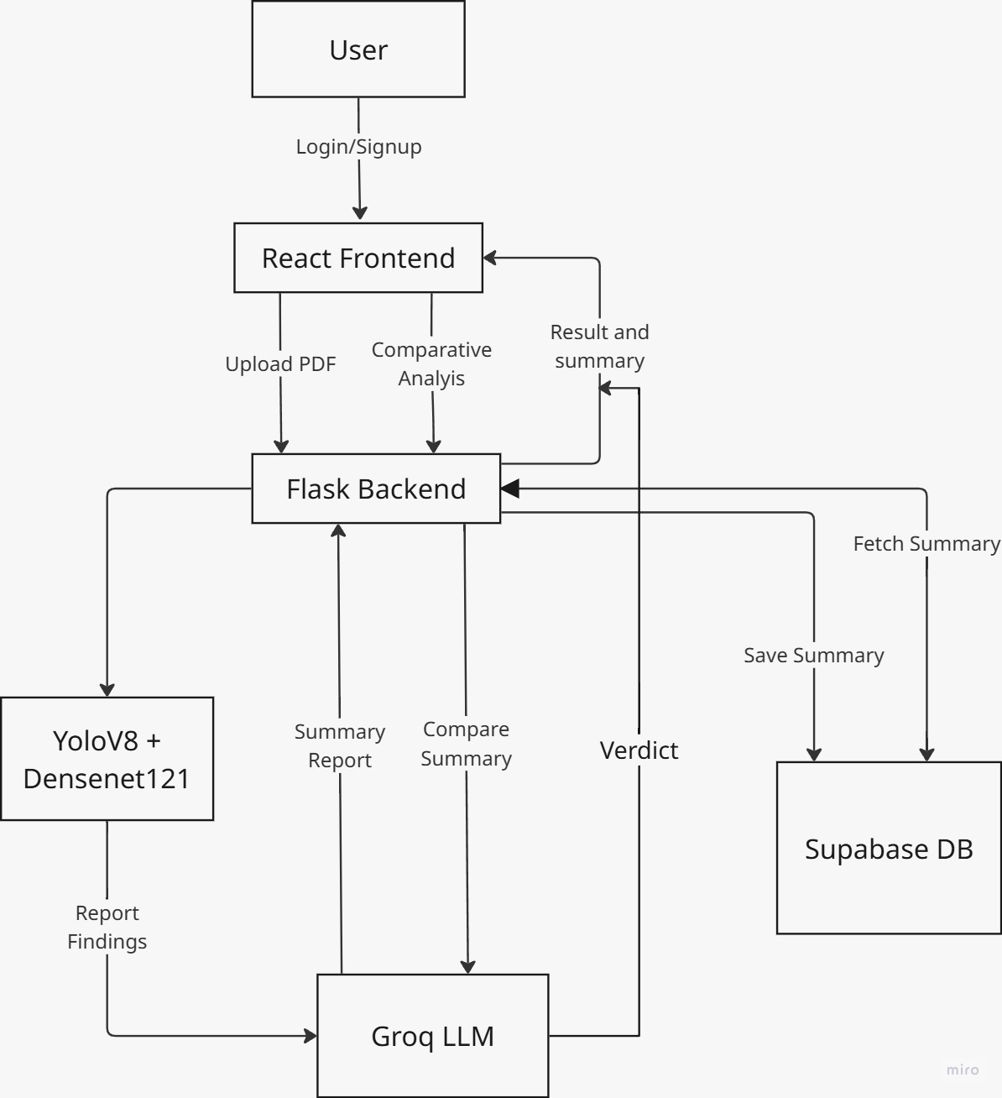
SYSTEM ARCHITECTURE
LucidCare, AI&DS

Slide 14
LEVEL 0 DFD
LucidCare, AI&DS

Slide 15
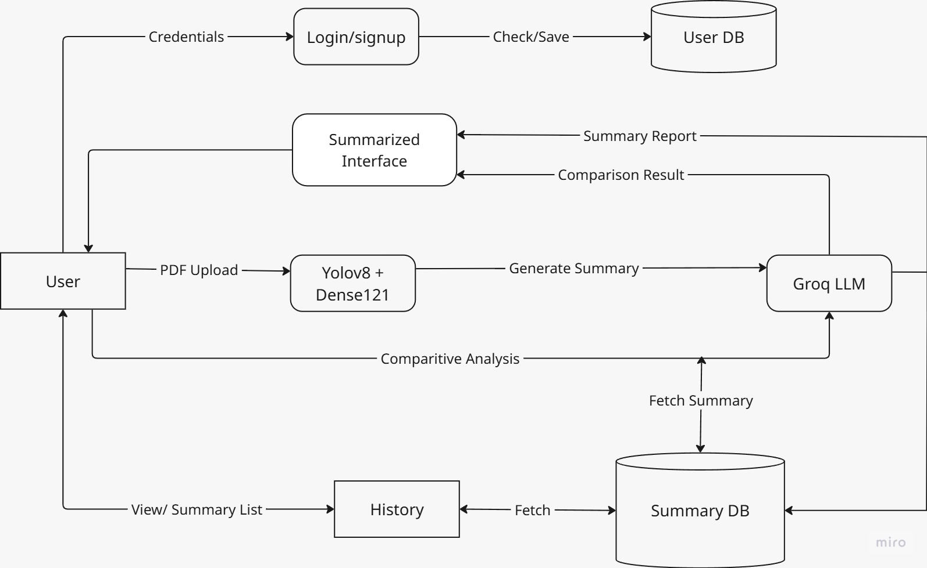
LEVEL 1 DFD
LucidCare, AI&DS

Slide 16
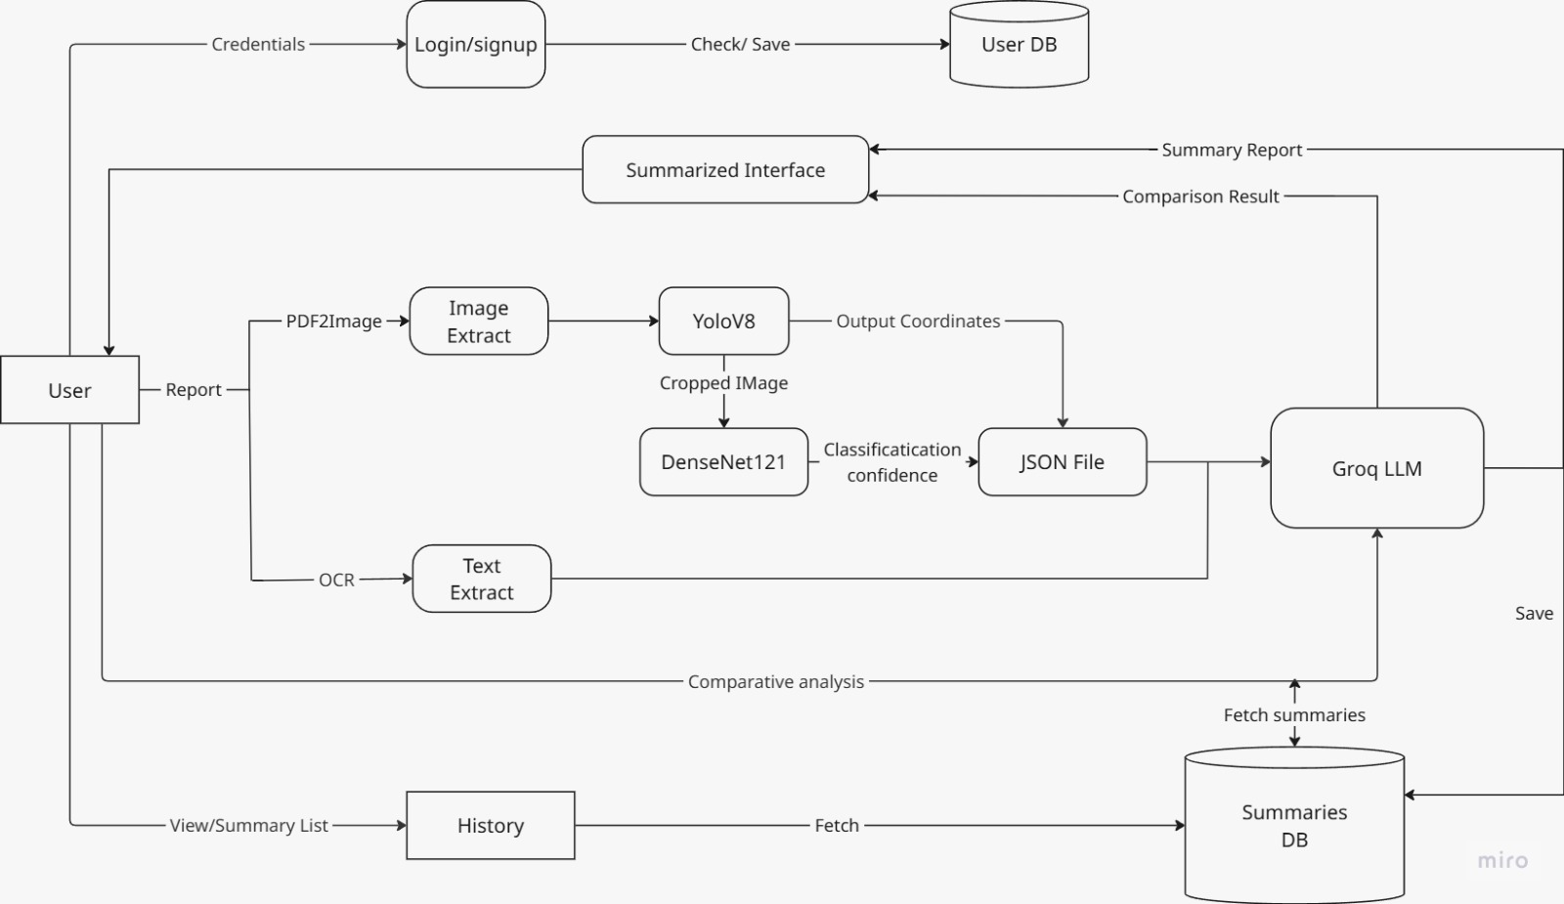
LEVEL 2 DFD
LucidCare, AI&DS

Slide 17
MODULES
1. React Frontend
Handles login and signup (authentication)
Allows upload of medical PDF reports and X-Ray images
Supports comparison with past reports
Displays results in a simple dashboard
Choose preferred language either English or Malayalam
2. Flask Backend
Connects frontend with AI models
Processes PDF input using OCR for text extraction and PDF2Image for image extraction, then forwards the processed data to AI models
Retrieves and organizes past records for comparison
LucidCare, AI&DS

Slide 18
MODULES
3. Vision Ensemble Model (YOLOv8 + DenseNet121)
Detector (YOLOv8):
Identifies ROI (Regions of Interest)
Detects abnormalities
Classifier (DenseNet121):
Classifies diseases from detected regions
Finds the confidence score of the disease
JSON Output:
Disease name
Confidence score
Location of abnormality
LucidCare, AI&DS

Slide 19
MODULES
4. LLM Integration (Groq LLM)
Adds JSON output + extracted text into the LLM function
Generates a clear, simplified medical explanation using XAI
Converts complex diagnostics into patient-friendly language
Acts as bridge between AI analysis and user understanding
5. Comparitive Analysis
Required summaries are fetched from the database
Summaries are fed to the Groq LLM for comparison
LucidCare, AI&DS

Slide 20
MODULES
6. Bilingual Explanations
When user selects English language, Groq LLM recognises it and generates the report in English
When user selects Malayalam language, Groq LLM recognises and generates the report in Malayalam
LucidCare, AI&DS

Slide 21
NOVELTY
Integration of Bilingual AI explanations for healthcare accessibility.
Comparitive analysis of patient health history
XAI in Groq-LLM gives simplified lay-man explanations.
LucidCare, AI&DS

Slide 22
DATA DESIGN
Medical Images (Chest X-Rays): NIH (Kaggle), RoboFlow
YoloV8:
Total dataset: 18,000 labelled dataset
Training: 80%
Validation: 10%
Testing: 10%
DenseNet:
Total dataset: 13,000
Disease categories: Normal, COVID-19, Tuberculosis, Pneumonia
Training: 80%
Validation: 10%
Testing: 10%
LucidCare, AI&DS

Slide 23
ALGORITHM
1. Upload & Data Extraction
Users upload medical reports in PDF format and selects their preferred language – English or Malayalam
System extracts text from report and image extraction for chest X-Rays images.
2. Image Analysis
AI detects abnormalities in the chest X-Rays images with help of Vision Ensemble Model.
LucidCare, AI&DS

Slide 24
ALGORITHM
3. Patient-Friendly Results
Converts complex medical terms into simple language with the help of LLM using XAI
4. Health Tracking & Comparison
Compares current reports with previously uploaded data
Highlights the improvements, or deteriorations
LucidCare, AI&DS

Slide 25
SOFTWARE AND HARDWARE REQUIREMENTS
Hardware Requirements: • CPU: AMD Ryzen 7 • GPU: NVIDIA RTX 4050 • RAM: 16 GB • Storage: 10 GB
Software Requirements • Operating System: Windows 11 • Core Technology: Python 3.9 • AI/ML Libraries: PyTorch / TensorFlow, Transformers, PDF2Image, OpenCV, Tesseract (OCR) • Backend: FlaskAPI • Database: SupaBase
LucidCare, AI&DS

Slide 26
COMPARITIVE STUDY
Model / Approach | Integration Architecture |  | Dataset Requirement | Accuracy / Performance | Limitations
Vision-Language Models (VLM) | Combines a vision encoder and language decoder to generate radiology descriptions or answer questions from medical images. |  | Requires very large multimodal datasets (image-text pairs such as MIMIC-CXR). | Typically 85–92% for report generation tasks depending on dataset and architecture. | Requires massive training data, limited transparency in clinical reasoning, mainly used for report generation rather than diagnosis.
Vision Transformer (ViT) | Transformer-based architecture where images are split into patches and processed using self-attention layers for classification. |  | Requires large labeled image datasets to train effectively. | Around 88–94% classification accuracy in chest chest X-Rays classification tasks. | Computationally expensive, lacks multimodal reasoning, does not interpret textual reports.
YOLOv6 Detection Model | CNN-based real-time object detection architecture for identifying abnormal regions in medical images. |  | Requires moderate-to-large annotated datasets with labeled bounding boxes. | Around 90–95% detection accuracy depending on dataset quality. | Detects abnormalities but cannot provide clinical explanation or textual interpretation.
Proposed Model – LucidCare | Hybrid multimodal architecture combining YOLOv8 for abnormality detection, DenseNet for classification, and an LLM for report interpretation. |  | Uses moderate medical imaging dataset with associated clinical reports (pulmonary disease dataset used for experimentation). | 98% classification accuracy across COVID-19, Pneumonia, Tuberculosis, and Normal classes. | Still limited by dataset diversity; future work includes expanding dataset and improving clinical validation.
LucidCare, AI&DS

Slide 27
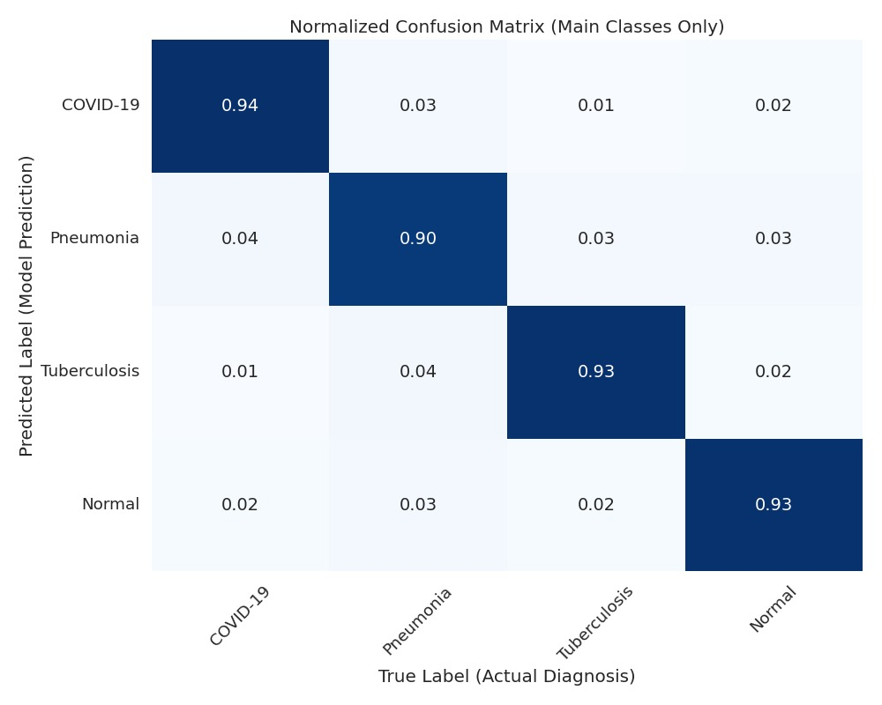
EXPERIMENTAL RESULTS
YoloV8 Confusion Matrix
LucidCare, AI&DS

Slide 28
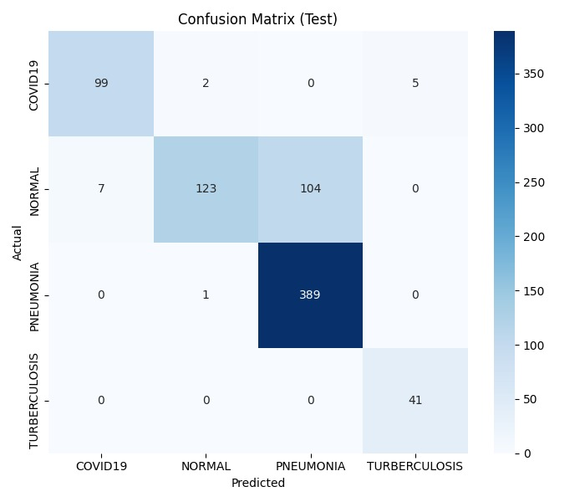
EXPERIMENTAL RESULTS
DenseNet121 Confusion Matrix
LucidCare, AI&DS

Slide 29
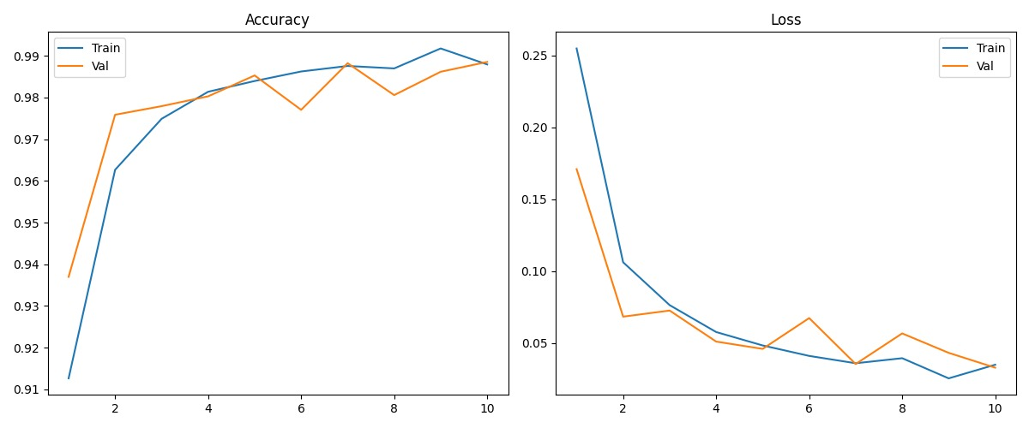
EXPERIMENTAL RESULTS
DenseNet121 Training Accuracy
LucidCare, AI&DS

Slide 30
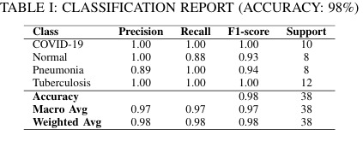
EXPERIMENTAL RESULTS
DenseNet121 Classification Report
LucidCare, AI&DS

Slide 31
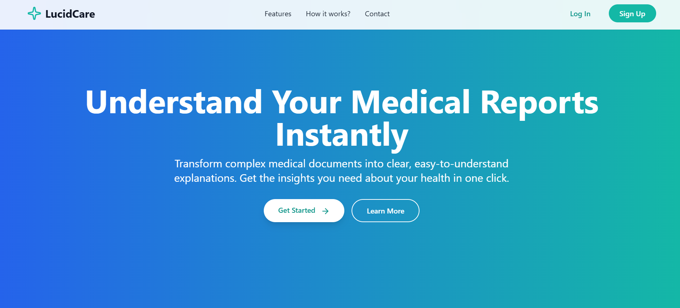
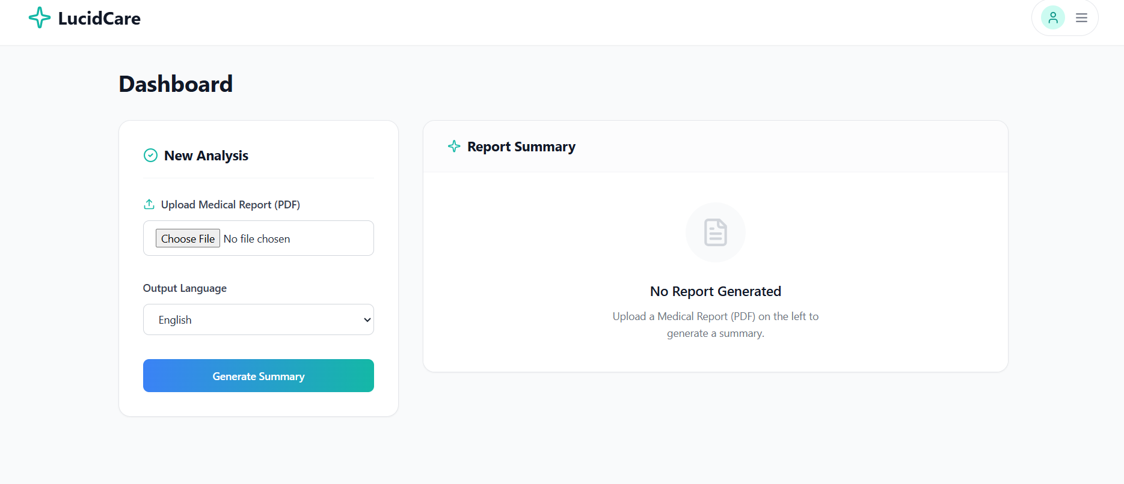
EXPERIMENTAL RESULTS
Landing Page
Dashboard UI
LucidCare, AI&DS

Slide 32
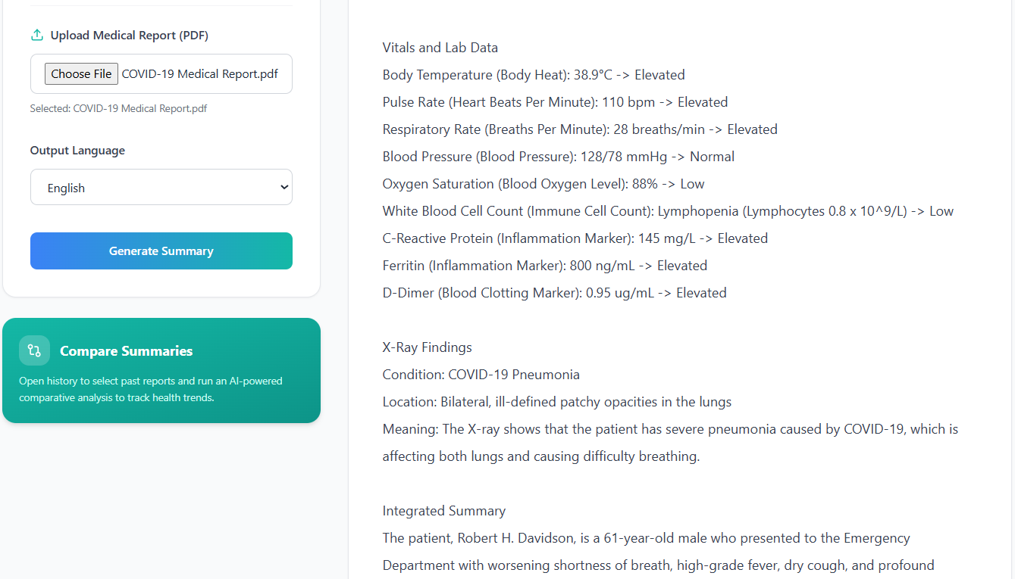
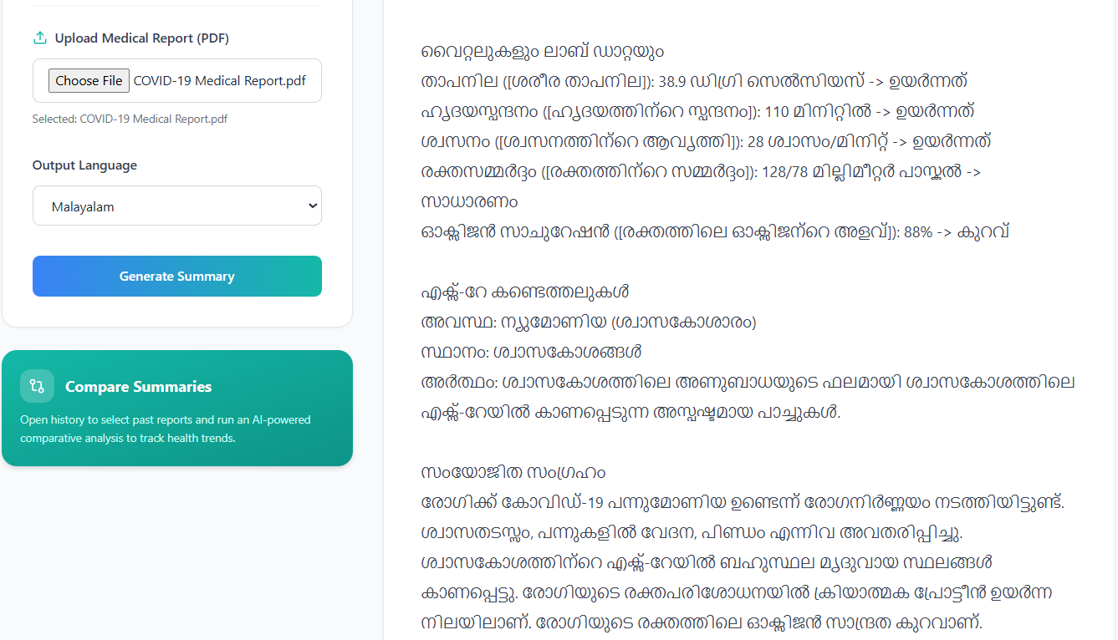
EXPERIMENTAL RESULTS
English Report
Malayalam Report
LucidCare, AI&DS

Slide 33
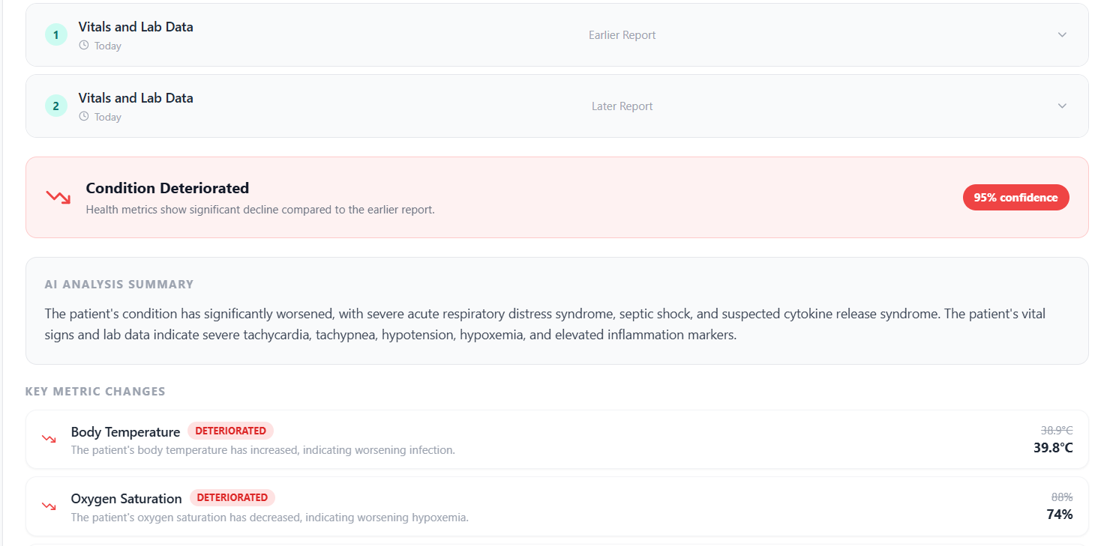
EXPERIMENTAL RESULTS
Comparison Report
LucidCare, AI&DS

Slide 34
PUBLICATIONS
Paper Title: LucidCare: An Explainable Multimodal AI System for Patient-Centric Clinical Report Interpretation Paper ID: 220
Conference: International Conference on Smart Communication and Sustainable Technologies (ICSCST 2026) Organised at: Saintgits College of Engineering Publication Status: Paper Accepted (Not yet published)
LucidCare, AI&DS

Slide 35
CONCLUSION
Our project delivers an AI-driven solution that makes complex radiology reports clear, visual, and understandable for everyone. By combining YOLOv8 + DenseNet121 for image analysis and LLM for natural language explanations, we generate accurate, patient-friendly reports with explainable AI.
Producing reports in Malayalam ensures that medical information is accessible to local communities, helping people better understand their health and make informed decisions with confidence.
LucidCare, AI&DS

Slide 36
FUTURE SCOPE
Data Security and Compliance Implement secure data handling, role-based access, and audit logs aligned with healthcare privacy standards.
Clinical Decision Support Expansion Position LucidCare as a decision-support and second-opinion tool rather than an autonomous diagnostic system.
Risk Stratification and Case Prioritization Extend the system to classify patients based on risk levels and urgency, helping clinicians prioritize critical cases instead of simply generating interpretations.
LucidCare, AI&DS

Slide 37
REFERENCES
[1] Park, Jiwoo, et al. ”Patient-centered radiology reports with generative artificial intelligence: adding value to radiology reporting.” Scientific Reports 14.1 (2024): 13218. [2] Naz, Zubaira, et al. ”An explainable AI-enabled framework for interpreting pulmonary diseases from chest radiographs.” Cancers 15.1 (2023): 314. [3] Ji, Yuelyu, et al. ”A vision-language model for generating textual descriptions of chest radiographs.” arXiv preprint arXiv:2405.13181 (2024). [4] Bluethgen, Christian, et al. ”A vision-language foundation model for the generation of radiology reports.” Nature Medicine 30.7 (2024): 2037-2046. [5] Hartsock, Iryna, and Ghulam Rasool. ”Vision-language models for medical report generation and visual question answering: a review.” Frontiers in Artificial Intelligence 7 (2024): 1430984.
LucidCare, AI&DS

Slide 38
REFERENCES
[6] Pahud de Mortanges, Aur´elie, et al. ”Orchestrating explainable artificial intelligence for multimodal and longitudinal data in medical imaging.” NPJ Digital Medicine 7.1 (2024): 195. [7] C¸ allı, Ezgi, et al. ”Explainable emphysema detection on chest radiographs with explicit radiologic signs.” IEEE Journal of Biomedical and Health Informatics 26.9 (2022): 4719-4730. [8] Anderson, Ian C., et al. ”Deep learning improves physician accuracy in chest chest X-Rays interpretation.” The New England Journal of Medicine 390.18 (2024): 1676-1685. [9] Sun, Zhaoyi, et al. ”A scoping review on multimodal deep learning in biomedical images and texts.” Journal of Biomedical Informatics 146 (2023): 104482. [10] Fi, Yuelyu, et al. ”RAG-RLRC-LaySum at BioLaySumm: Integrating Retrieval-Augmented Generation and Readability Control for Layman Summarization of Biomedical Texts.” Proceedings of the 2024 Workshop on Biomedical Natural Language Processing and BioNLP Shared Tasks (2024): 810-817.
LucidCare, AI&DS

Slide 39
THANK YOU
LucidCare, AI&DS

